Slide 1


12 Months of Python
from VLOOKUP( ) to import from

Slide 2

02
01
03
04
My Message
It is never too late
To be on the right mind space
Python is just the beginning
A lifetime of learning
The best teacher is the real world
Tools are for solving problems
05
06

Slide 3

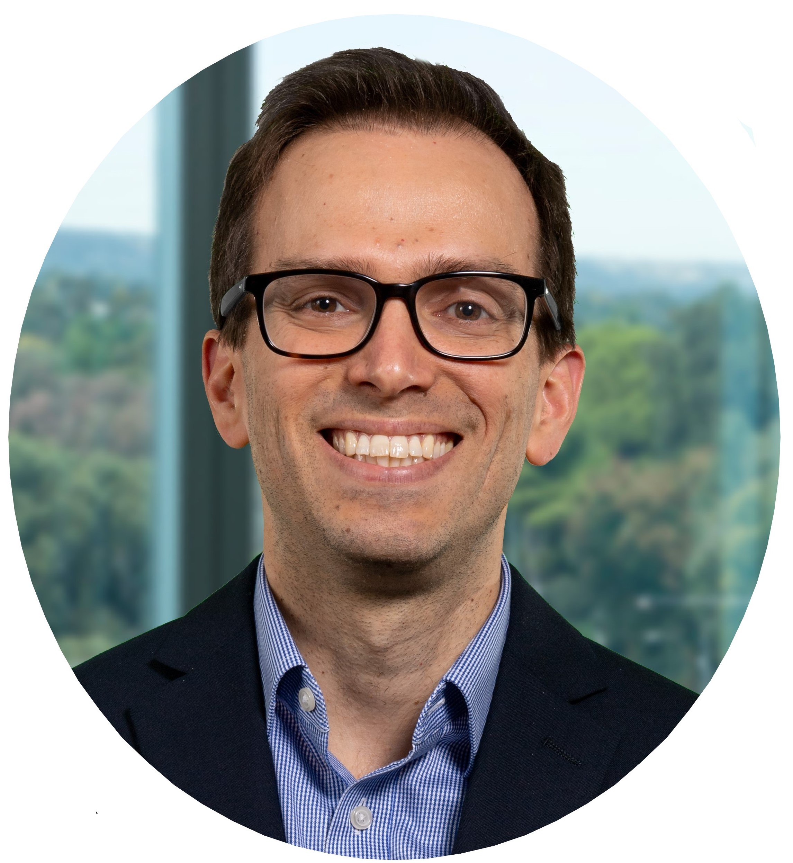

ABOUT me
Pedro Junqueira
Data Scientist @ Capgemini
pedrocj@gmail.com
@velaepavio
pedrojunqueira
537184

Slide 4
My Coding career
BASIC/MS-DOS
1985
1992
Windows and Internet
Excel hell
2000
2008
Trading Systems
SQL/Python and beyond
2017

Slide 5

01
It is never too late
9 years old
39 years old

Slide 6
02
To be on the right mind space
I can’t do it
I can do it

Slide 7
03
Python is just the beginning
There is so much to learn
Git
Bash
API
Docker
Web
CI/CD

Slide 8
04
A lifetime of learning
Average about 10 – 20h a week of extra working on learning

Slide 9
27,722 minutes on Udemy

Slide 10
05
The best teacher is the real world
No matter how much you simulate do projects and study there are things you will only learn by doing at a real job, so do not be afraid of been thrown in the “deep end”

Slide 11
06
Tools are for solving problems
“If the only tool you have is a hammer, everything looks like a nail”
Understand the problem the client is trying to solve

Slide 12
Do Projects and Build Things
Dashboard-Covid19
API on Docker containers
Dash, Pandas, Requests, Plotly, Heroku
Docker, Docker-Compose, Flask, sqlalchemy, PostgreSQL, NGINX, Gunicorn, Heroku (PaaS)
https://github.com/pedrojunqueira/Covid19Heroku
https://github.com/pedrojunqueira/Flask-Nginx-PostgreSQL-on-Docker
ML Production
Linear Algebra
Flask, NLP, Gunicorn, ProstgreSQL, sqlalchemy, Sklearn
Explanation of Linear Algebra on my own words and coding in Python
https://github.com/pedrojunqueira/IMDb_flask
https://github.com/pedrojunqueira/Essense-of-Linear-Algebra

Slide 13

Keep moving

Slide 14
Recommended Resources
Online courses
* Machine Learning A-Z™: Hands-On Python & R – Kirill Eremenko
* Complete Python Bootcamp: Go from zero to hero – Jose Portilla
* Dataquest Data Scientist in Python
* Become a probability and statistics master - Krysta King
* Coursera Deep Learning Specialization – Andrew Ng
* The complete web development Bootcamp – Angela Yu
* 100 days of code with Python – Bob, Julian and Michael
* TDD with Python, Flask and Docker – Michael Herman
* The complete JavaScript course – Jonas Schmedtmann
Podcasts
* Super Data Science – Kirill Eremenko
* Data Framed – Hugo Bowne-Anderson
* Talk Python to me – Michael Kennedy
* Artificial Intelligence – Lex Fridman
* Test and Code – Brian Okken
Books
* The Definitive Guide to DAX – Alberto Ferrari and Marco Russo
* T-SQL fundamentals - Itzik Ben-Gan * Python Machine Learning – Sebastian Raschka
* Hands–On Machine Learning with Scikit–Learn and TensorFlow – Aurelien Geron
* Deep Learning for Computer Vision – Adrian Rosebrock
* Deep Learning with Python - Francois Chollet
* Python Testing with Pytest – Brian Okken
* The Well-Grounded Python Developer – Doug Farrell
Blogs
* Real Python
* PyImage Search (CV)
* Miguel Grinberg - Flask Mega tutorial
* Kevin Markham – Data School
YT
* Corey Schafer
* 3Blue 1Brown – Grand Sanderson

Slide 15
What is next ?
Machine Learning Engineering
Shinny
Asyncio Python
FastAPI
Java (Kafka, Spark)
Pytorch
JavaScript (React)
Django
Kubernetes
Mongo DB

Slide 16

THANKS!
Do you have any questions?
pedrocj@gmail.com
+61 0417 880 963
https://pedrojunqueira.github.io/blog/

